Slide 1
1. Flow chart 11. Benchmarking
Li Nita

Slide 2
1. Flow chart

Slide 3
What is project management process Flow chart?

Slide 4
What is project management process Flow chart?
A project management process flowchart is a graphical aid, designed to visualize the sequence of steps to be followed throughout the project management process.
In other words, it streamlines the flow of activities.
It is one of the seven basic quality tools used in project management
Project managers use a flow chart to offer a clear picture of process and to find ways to improve project efficiency.
With flowchart in place, the project team always know what comes next and the process can function as smoothly and efficiently as possible.

Slide 5
Why use a Project Management Process Flowchart?
The purpose of flowchart is to help visualize required steps which especially is important for a project management process.
It aids in the understanding of complex systems, which helps us easily drive projects to successful ends.
The goal of the process flowchart is clarity and transparency.
Once the project management process flowchart has mapped out the steps of each phase of the project and assigned ownership of responsibilities, everyone fully understands their roles, and how they can contribute to the whole.

Slide 6
Why use a Project Management Process Flowchart?
By using a flowchart to visually document your project, we can:
Illustrate the sequence of activities required for its completion
Highlight possible work flow issues
Find out about areas where efficiency, quality or performance can be improved
Show high volumes of information on a single screen thus allowing us to handle large amounts of information
It is easy to create.

Slide 7
What are the steps?

Slide 8
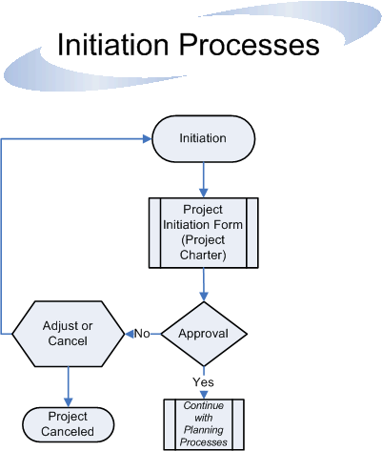

Slide 9
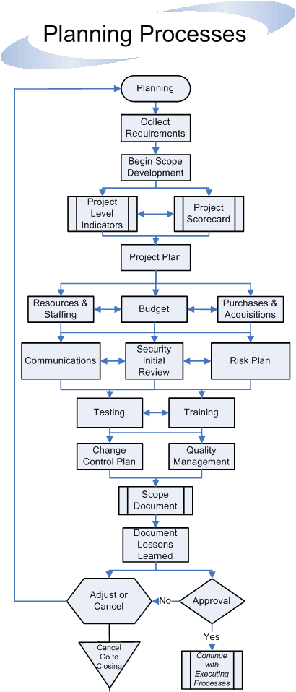

Slide 10
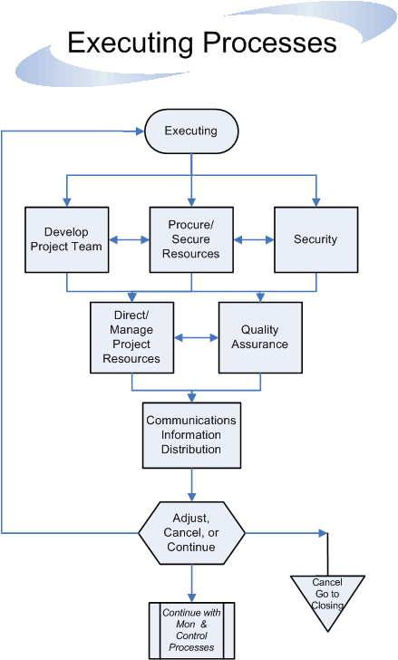

Slide 11
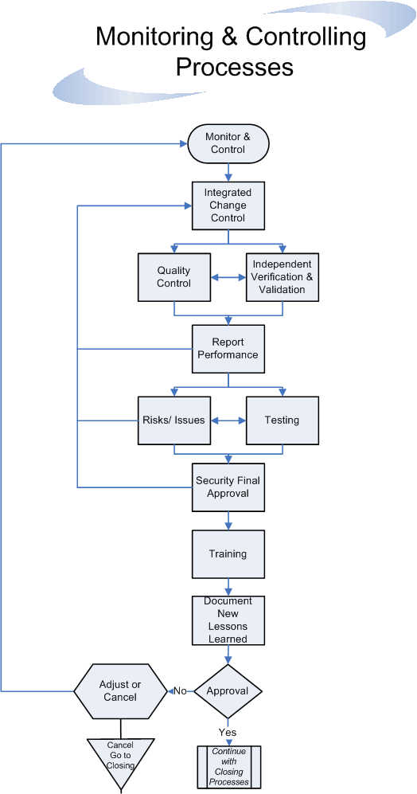

Slide 12
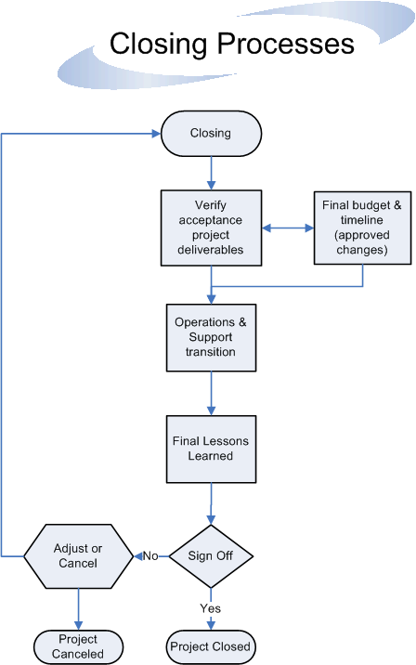

Slide 13
ii. Benchmarking

Slide 14
What Is Benchmarking in Project Management?
Benchmark project management is the process of continuously comparing the project management practices of your organization with the project management practices of leaders anywhere in the world; its goal is to gain information to help you improve your own performance.
Benchmarking in project management is a strategic planning and research process. The goal is to identify and measure data and compare results to improve project management.

Slide 15
Why do Benchmarking?
Benefits of Benchmarking in Project Management
The benefits of tracking the performance of a team or project against competitive metrics in project management are clear.
Assessment: Project managers and team members get the performance feedback necessary to succeed in their role and make the right decisions.
Accountability: Using benchmarking improves collaboration with stakeholders and holds project teams accountable to results.
Identify process gaps: The practice sheds light on potential risks and problems with the process. Businesses can address these issues, so they aren’t a hurdle in future projects.
Continuous improvement: Benchmarking ensures that decision-makers are aware of what’s working and what’s not so that they can make improvements.
Meet business goals: Identifying and tracking the right metrics to measure performance helps organizations progress toward larger objectives.

Slide 16
Benefit of Benchmarking in IT projects
Measuring cost of project delivery against industry benchmarks to assess whether the IT function is cost effective;
Identifying aspects of project delivery that are problematic and can be improved so as to reduce the cost of project delivery in the future;
Measuring the effect of improvements over time by charting the trend of the measurements over time;
Demonstrating the relative value of the IT function to senior management, based on comparative costs of other organisations, as shown by the benchmark results;
Comparing the measurements of different technologies used in projects, so as to decide on the most cost-effective technologies to use in the future;
Using historical measurements of the organisation and other organisations to validate estimates, either internal or supplier sourced;
Benchmarking can therefore help answer questions such as: Do you deliver projects on-time? Do you deliver projects within budget? Do you deliver quality products? Is your process predictable? How does your performance compare to that of your competitors? Is your performance world-class? What are the problem areas to be addressed? Are we improving?
The implementation of steps to address the identified short-falls can then result in high performance project delivery, meaning: High productivity, high speed delivery, high quality (freedom from error), conformance to requirements, conformance to plans, and low cost.

Slide 17
Benchmarking Against What?
Benchmarking requires that we have something to compare the actual project delivery measurements against. Some possible benchmarks to compare project delivery against are:
The organisation's own projects from previous years;
Projects from other organisations in the same industry (competitors);
Projects from other organisations in the same country;
Projects from other organisations in the world.

Slide 18
Types of benchmarking to use in project management
Internal: use these standards to compare and evaluate internally-based projects that are comparative in size and scope. Once you’ve set benchmarking standards, you can use these to make recommendations for future projects and accurately determine success.
External: External benchmarking in project management is a method of collecting and analyzing performance metrics from external sources with internal progress. To find external data that you can compare internal processes against, you’ll need to work with a partner or third-party consultants.
Competitive: Competitive project benchmarking uses data from direct competitors or industry standards to determine how well your projects meet objectives. Information for competitive benchmarking can come from a range of sources, including:
Market trends
Independently created competitor analyses
Publicly available competitor information (e.g., pricing, customer reviews, etc.)
Published profits, stock information, market shares, etc.

Slide 19
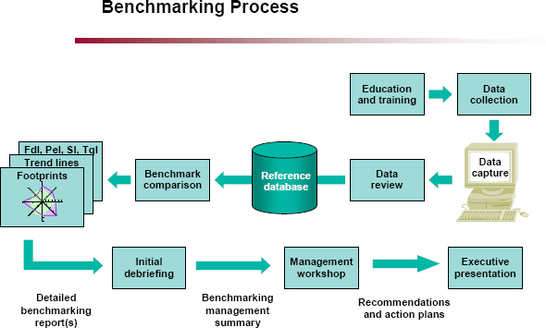
How does the Process Work?

Slide 20
references
https://twproject.com/blog/flowchart-important-project/
https://project-management-knowledge.com/definitions/f/flowchart/
https://www.projectmanager.com/blog/sample-project-management-flow-chart
https://it.vt.edu/projects/project_management/process/processflow.html
https://getnave.com/blog/benefits-project-management-process-flowchart/
https://www.netsuite.com/portal/resource/articles/erp/project-management-benchmarking.shtml#:~:text=What%20Is%20Benchmarking%20in%20Project,results%20to%20improve%20project%20management.
https://www.pmi.org/learning/library/benchmarking-approach-managing-it-project-7645#
https://monday.com/blog/project-management/benchmarking-in-project-management/
https://www.aresprism.com/blog/benchmarking-project-management/
https://www.hydra.cloud/en/resources/blog/the-essential-guide-to-project-benchmarking
https://www.ipaglobal.com/news/article/what-is-project-benchmarking/
https://www.projectmanagement.com/contentPages/wiki.cfm?ID=233027&thisPageURL=/wikis/233027/Benchmarking#_=_
https://pmtips.net/article/benchmarking-in-project-management

Slide 21
Thank you!

